Slide 1
INTRODUCTION TO EMBRYOLOGY
Dr. Mbira

Slide 2
Embryology literally means the study of embryos.
It is the branch of anatomy that deals with the prenatal(before birth) development of the human from conception(fusion of the sperm and the ovum) to the fully formed “baby”(foetus) just before birth.
It encompasses aspects of developmental anatomy which studies the changes and progress in structures from a germ cell(sperm/ova) to the adult.
It also involves teratology which is the study of defects in development and the possible aetiological factors, whether genetic or environmental.

Slide 3
Embryology therefore:
Bridges the gap between prenatal development and obstetrics, perinatal medicine, pediatrics, and clinical anatomy.
Develops knowledge concerning the beginnings of human life and the changes occurring during prenatal development.
Is of practical value in helping to understand the causes of variations in human structure.
Illuminates gross anatomy and explains how normal and abnormal structures develop.

Slide 4
The first 8 weeks represent the period of most rapid and complex change from conception to forming primordial organs, at which point the embryo starts to resemble a fully formed human. This period is called the period of embryogenesis or organogenesis.
From 8 weeks till birth is called the foetal period and is characterized by an increase in size and weight as well as the final processes in the development of the various organs.

Slide 5
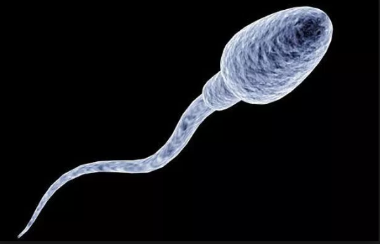
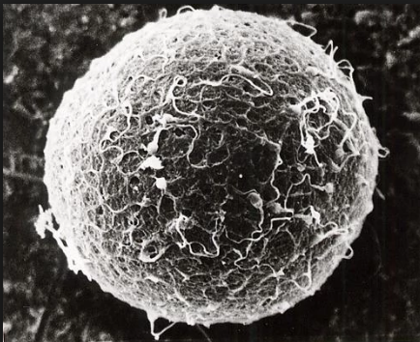
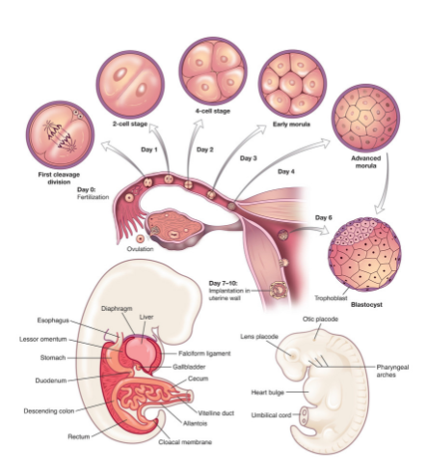
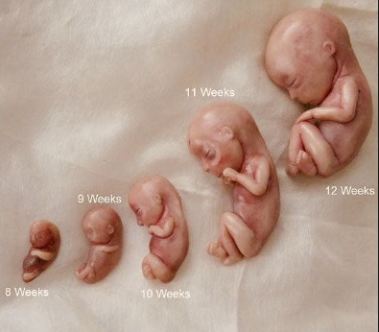
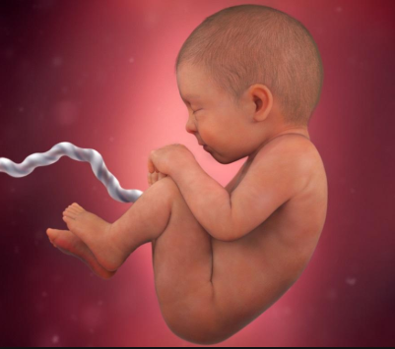

Slide 6
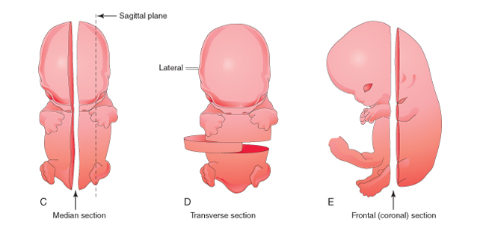
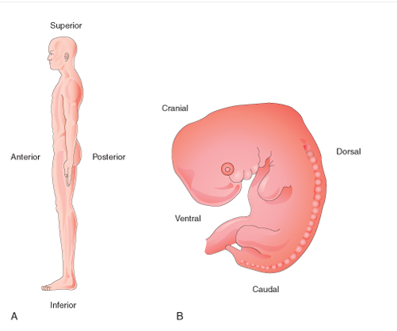
Descriptive terms

